Slide 1
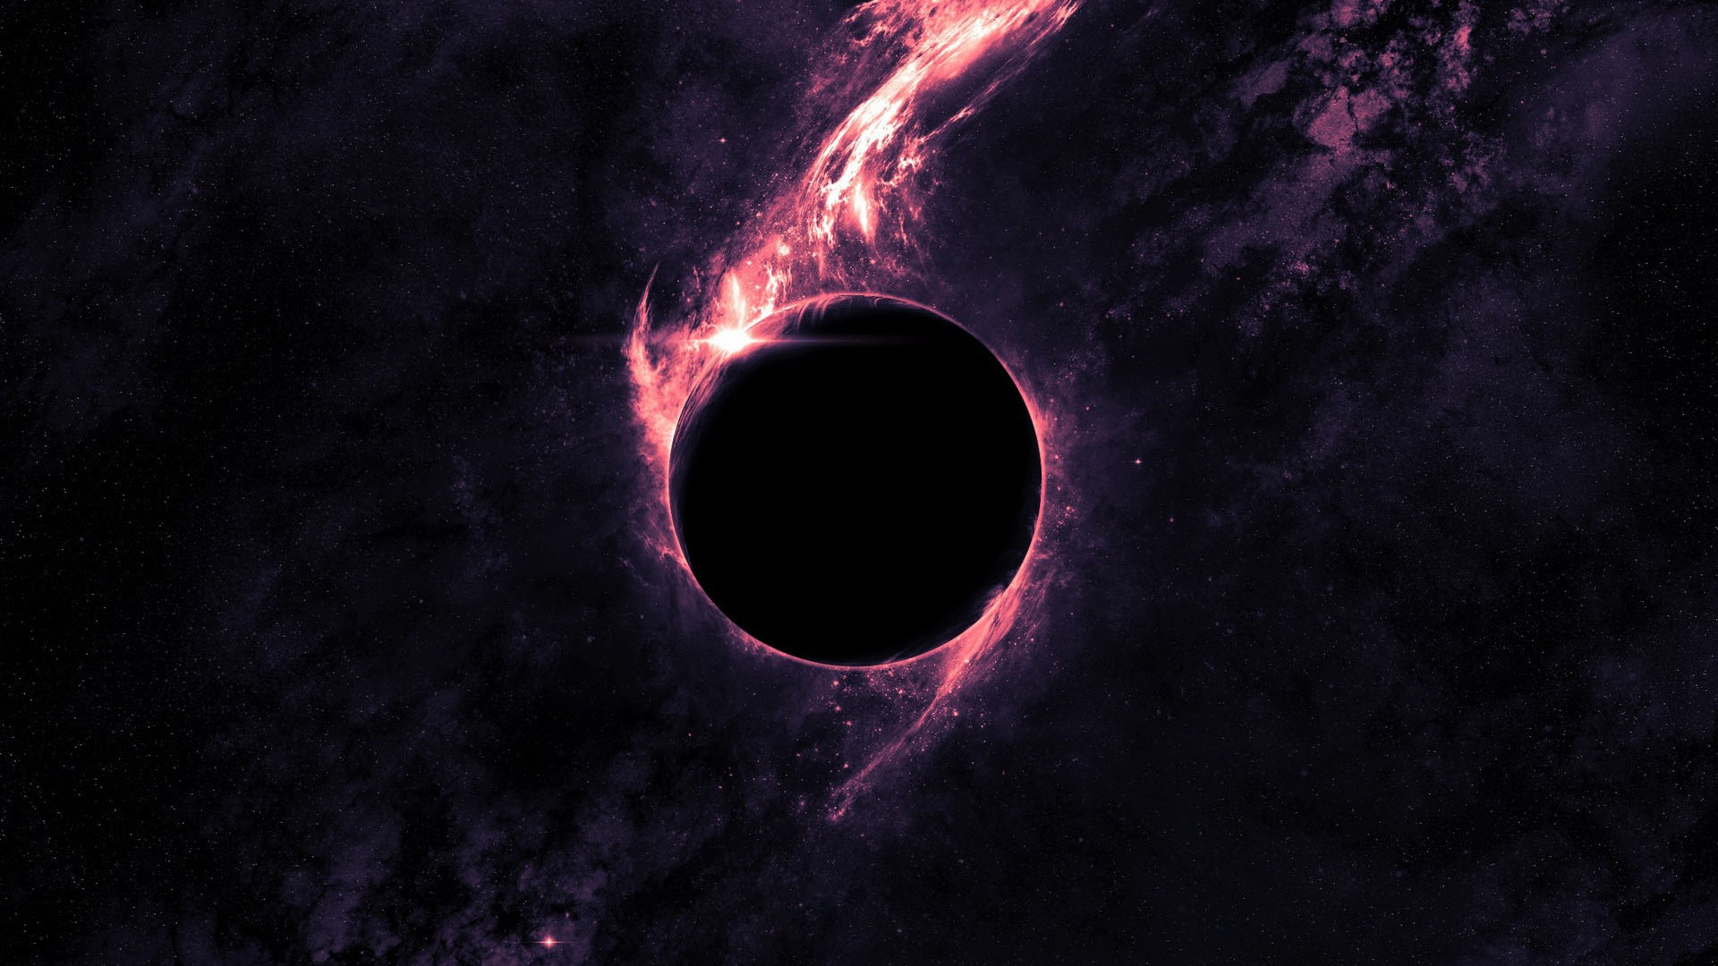
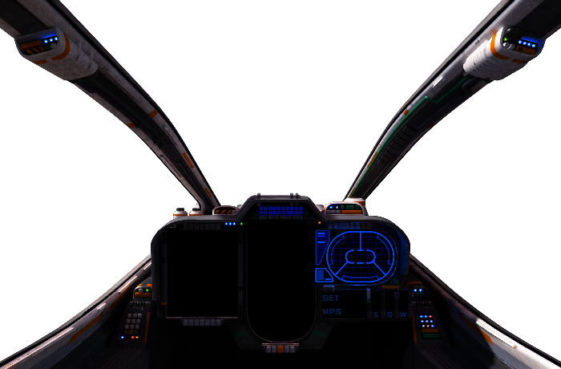
Black Holes
Chad Peterson
&
His Relativistic Serenity, Dr. Nikodem Poplawski

Slide 2
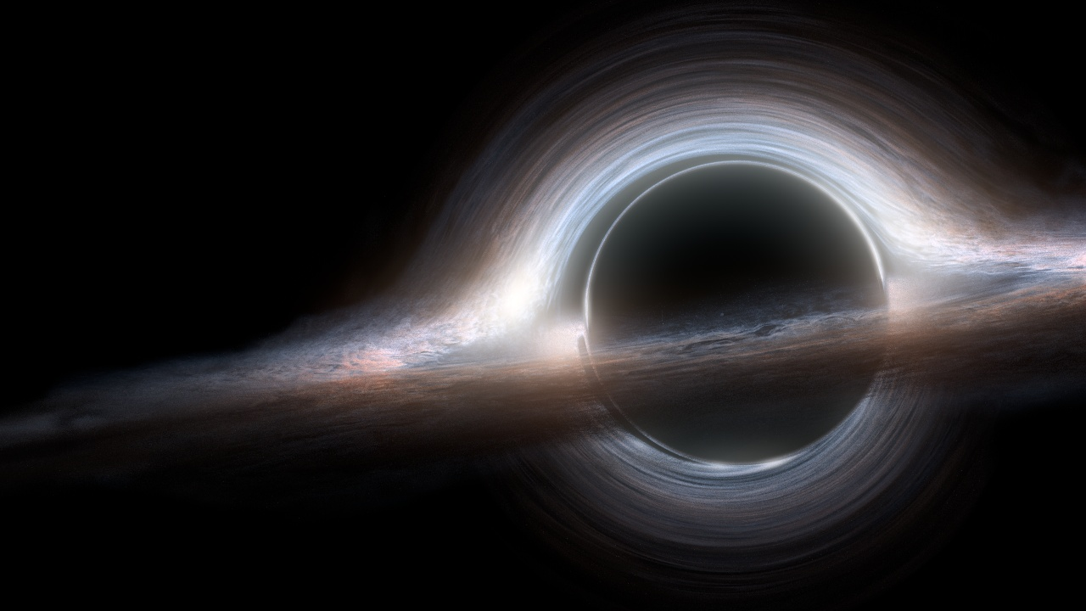
Previous Research
Einstein–Cartan–Sciama–Kibble theory

Slide 3
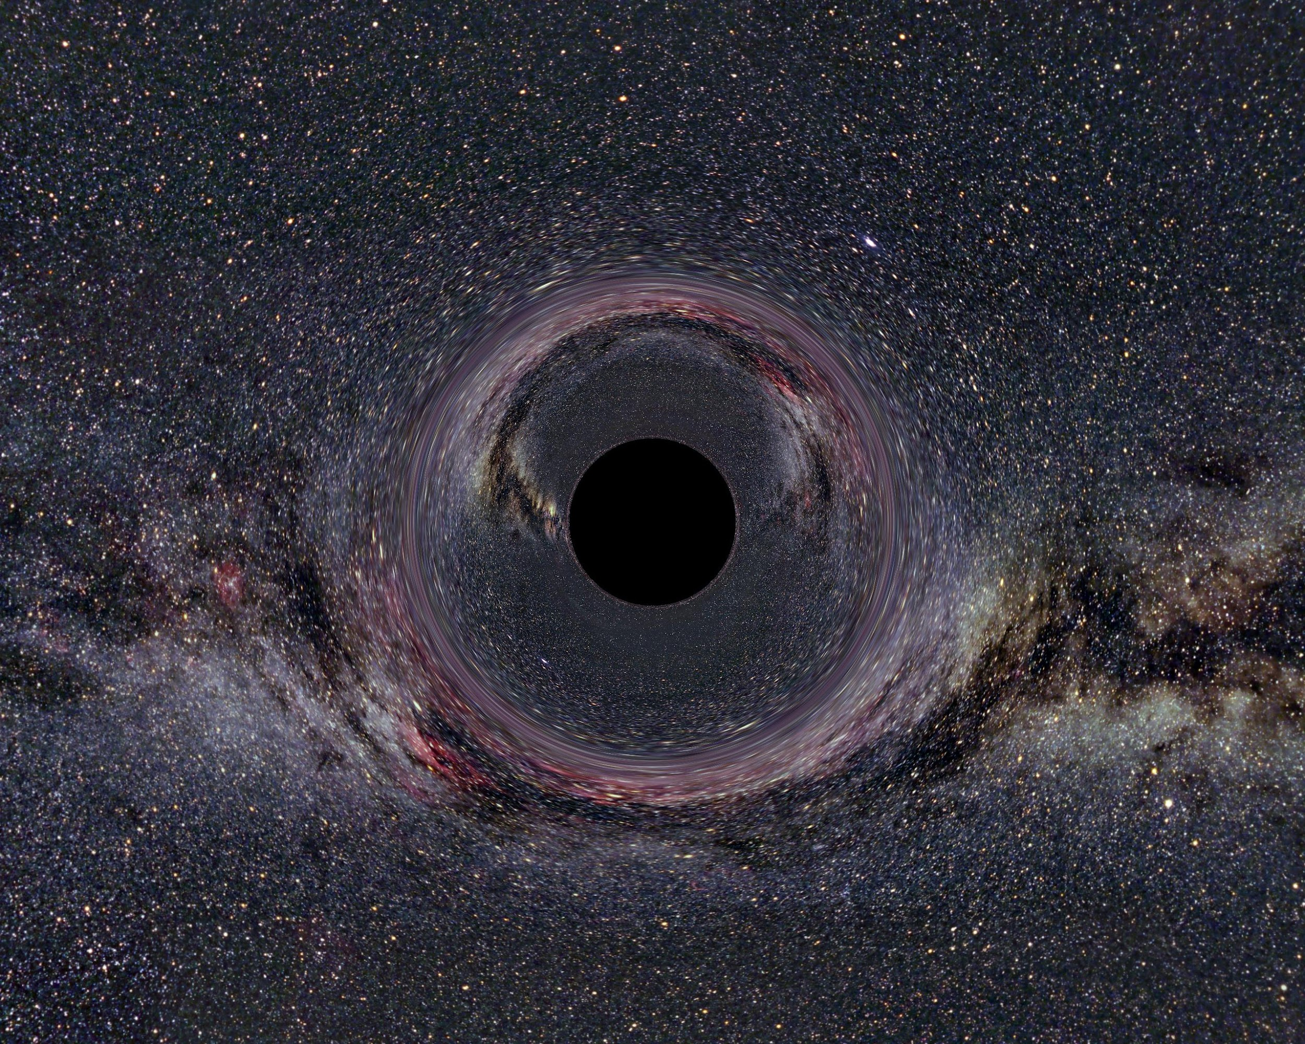
Question & Objective
Does this mathematical model accurately depict a black hole and how the universe forms?

Slide 4
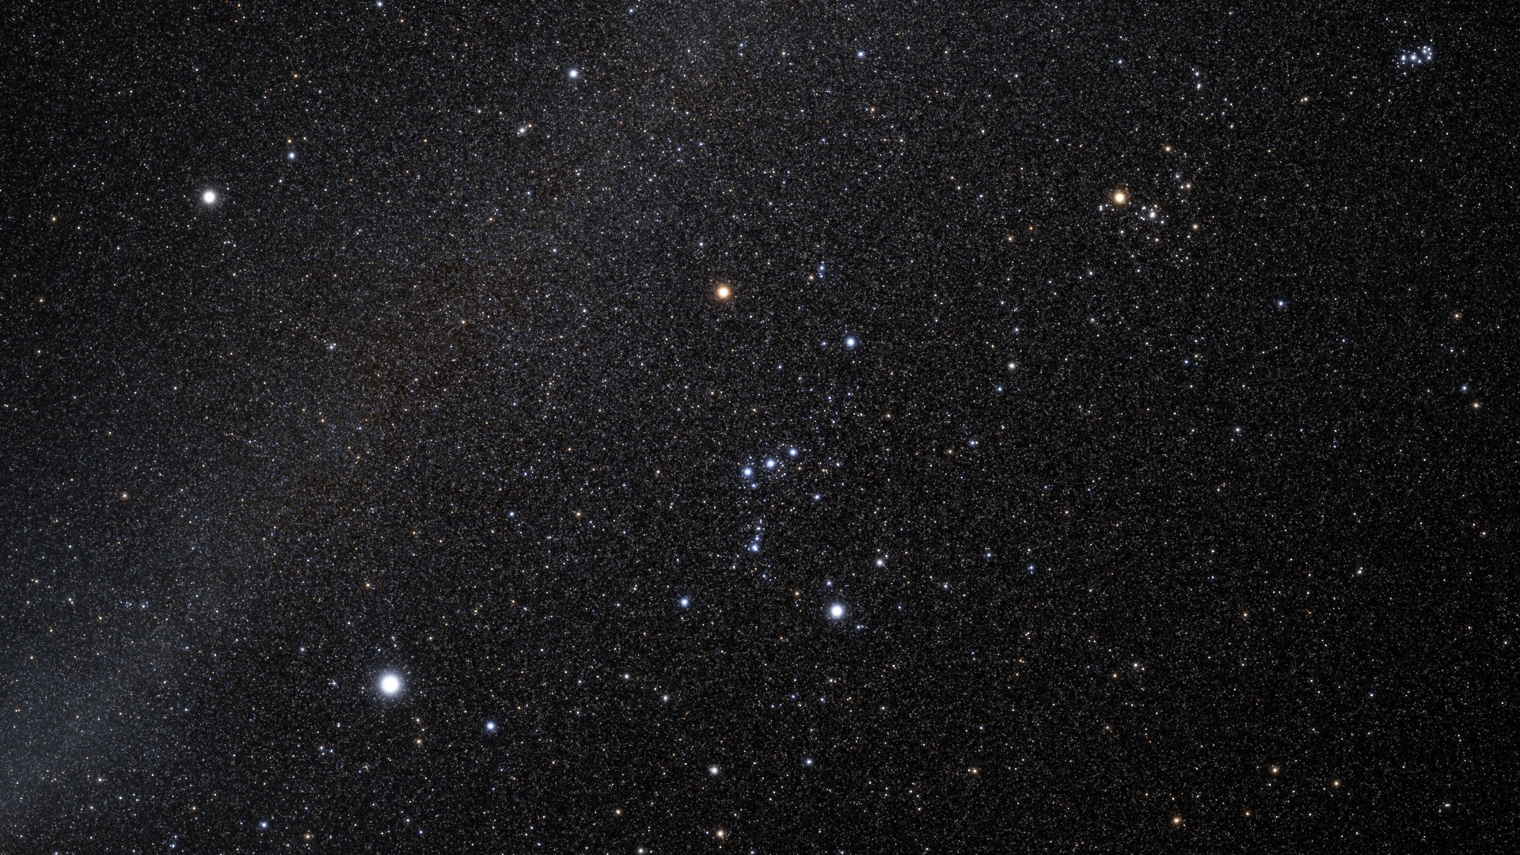
Expectations
After a certain amount of time the black hole will stop ‘bouncing’ and will consequently grow for forever

Slide 5
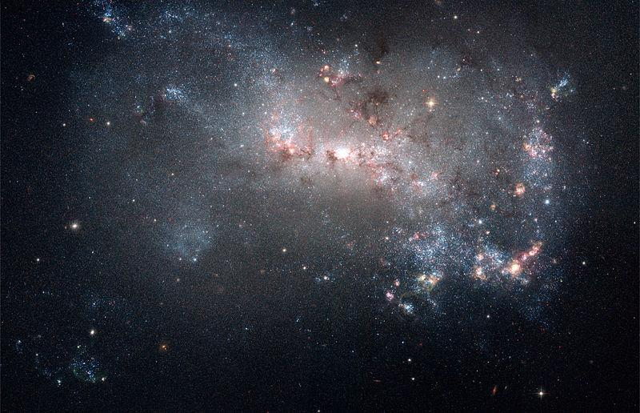
Method
Program the mathematical model in computer and simulate results
Compare results to observations the CMB

Slide 6
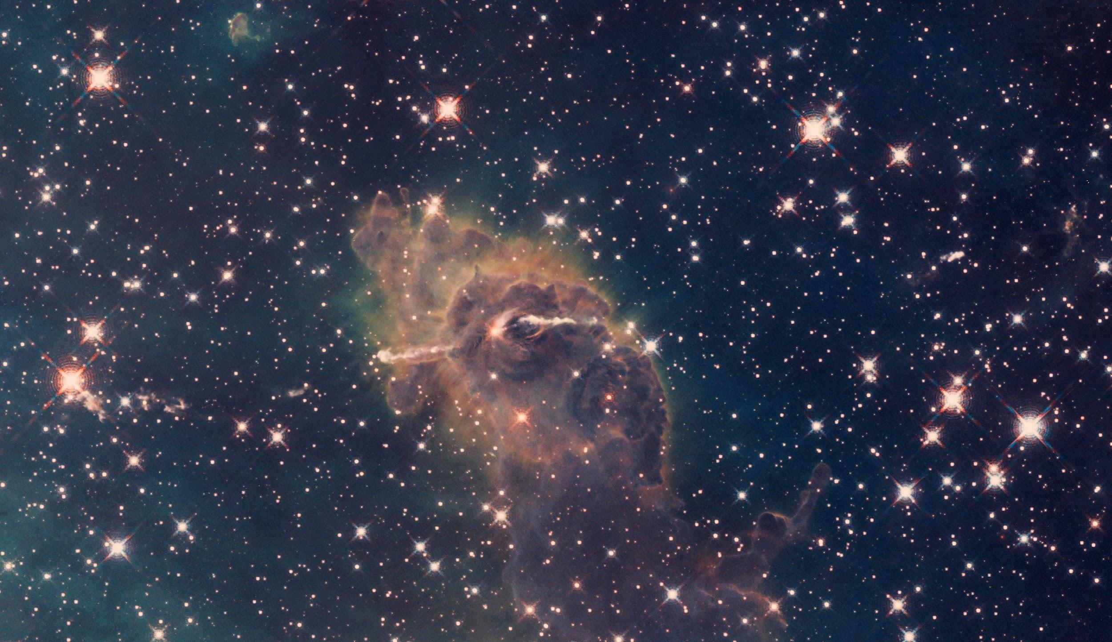
Results & Graphs
Completed
-Trochoid
-Bounces
-Particle Production added factor to program which allows for particle production each bounce
Up Next
-Infinite expansion add factor to program which will allow for infinite expansion

Slide 7
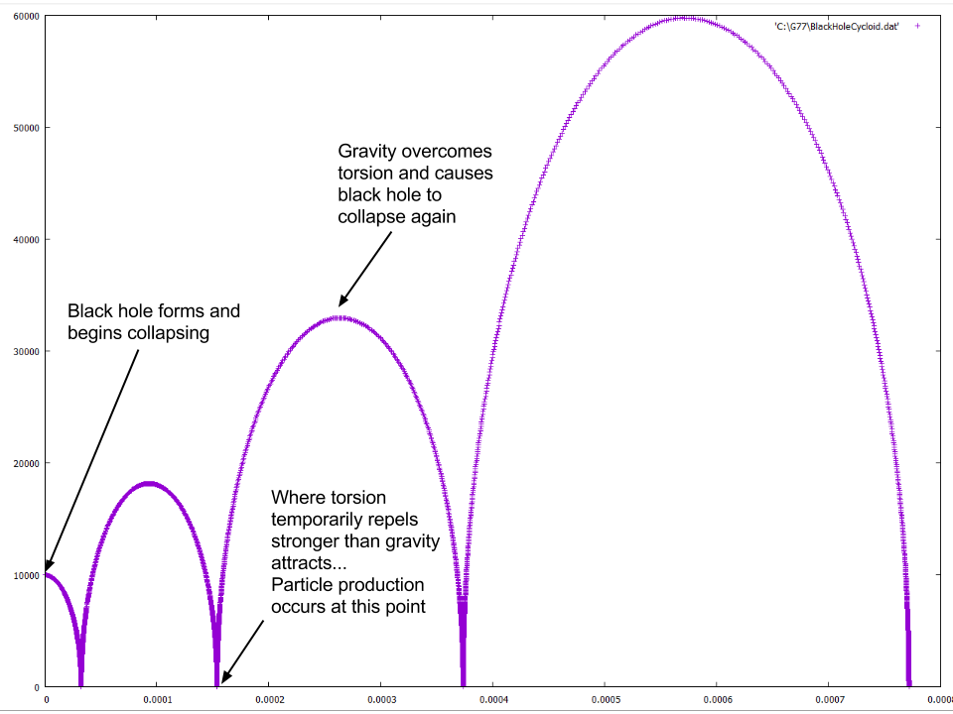

Slide 8
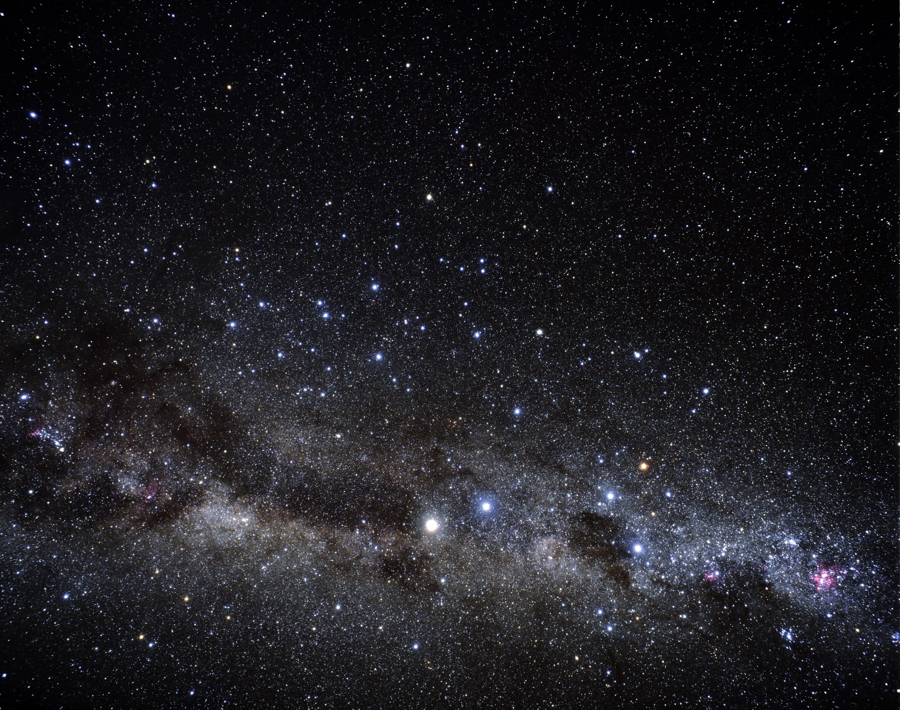
Conclusions
Each factor from our mathematically derived added produces the results we hypothesized.
Once the program is finished we can compare the results to our universe for a final answer.

Slide 9
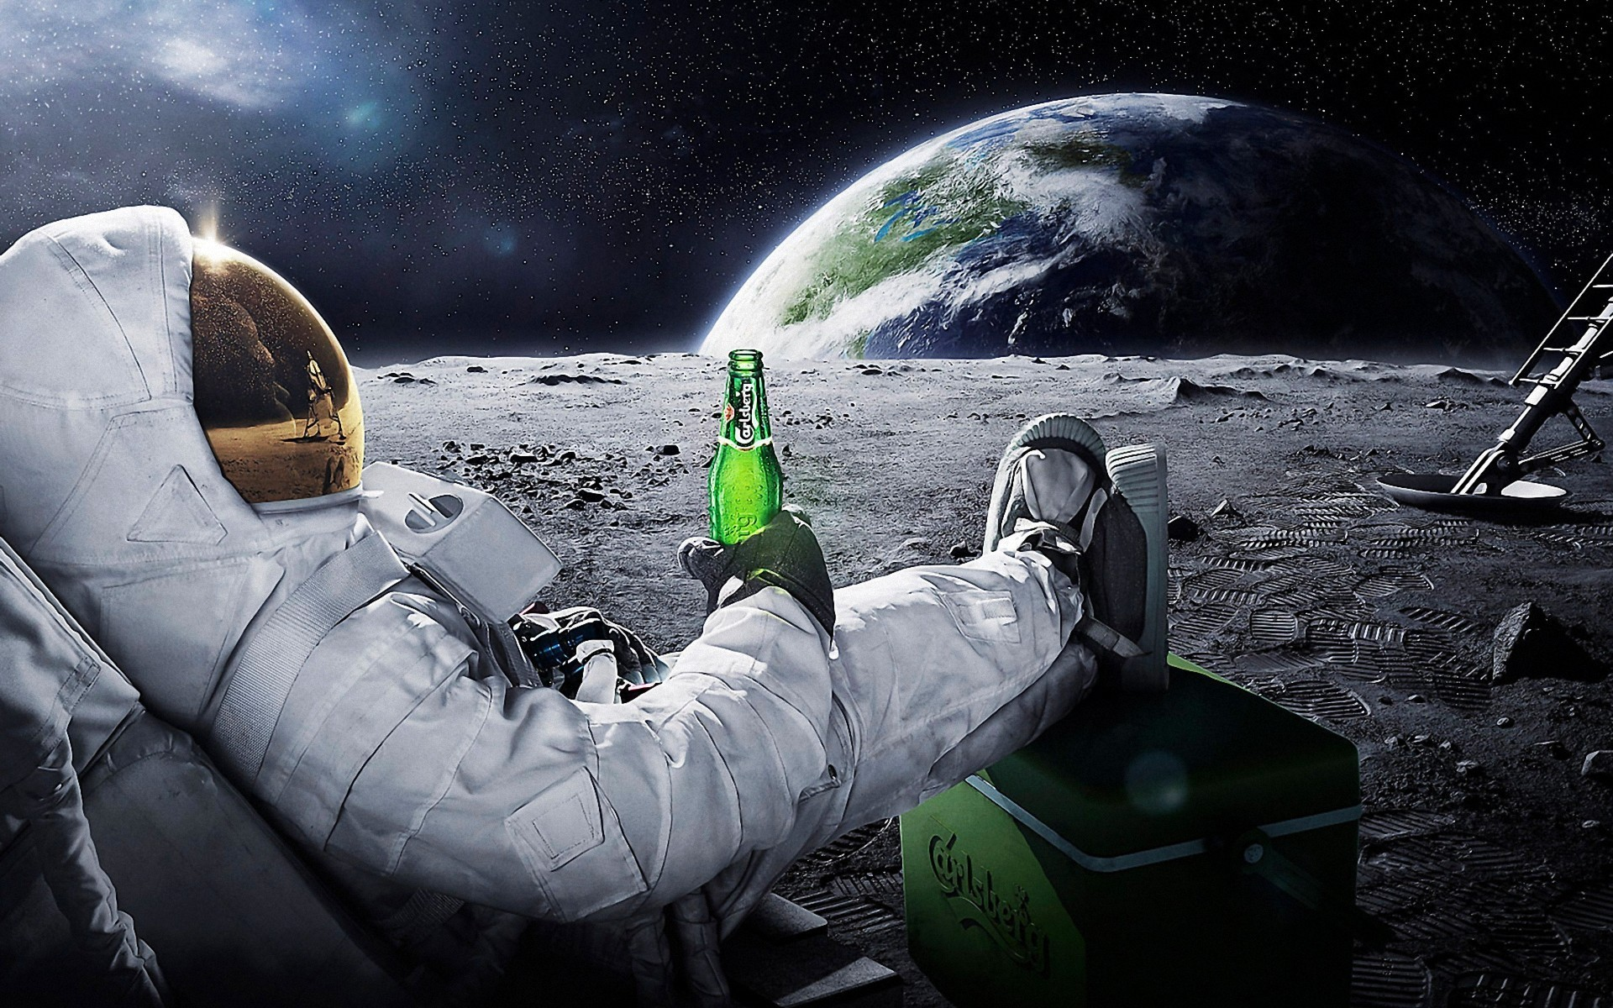
Questions

